Slide 1
N-Queen Algorithm
Group Members :
Muhammad arbab anjum
Syed ali abbas
Qaiser abbas
Aqib Mehmood

Slide 2
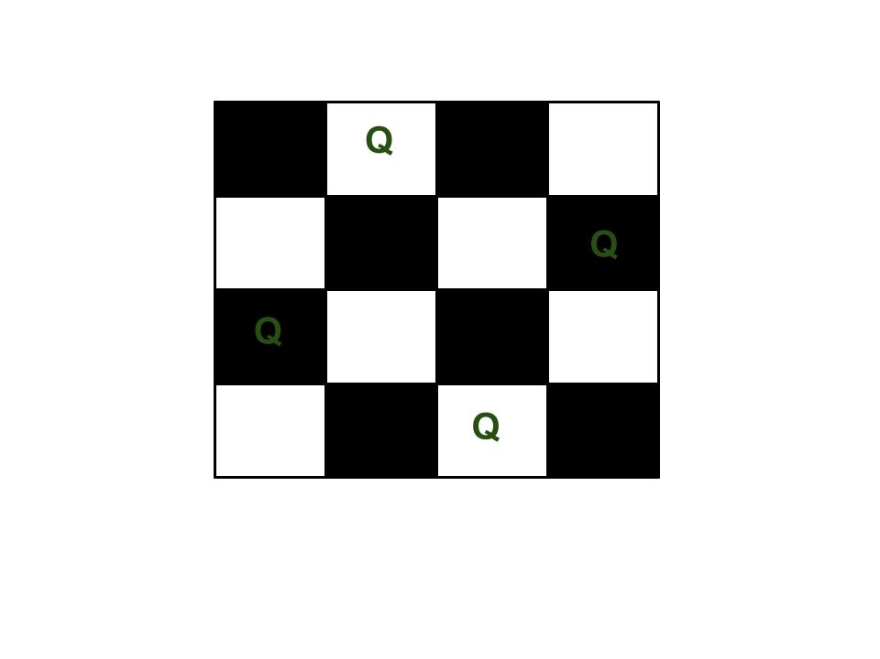
What is N-Queen?
The N Queen is the problem of placing N chess queens on an N×N chessboard so that no two queens attack each other.

Slide 3
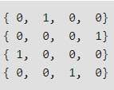
Binary view:
The expected output is a binary matrix which has 1s for the blocks where queens are placed. For example, following is the output matrix for above 4 queen solution.

Slide 4
How it happens ?
Observe carefully in four(4) directions (North, South, East and West)
And diagonals. Each Queen needs to be placed in such a place that they cannot kill one another.
 | Q2

Slide 5
What we are using ?
Back Tracking Method :
Using back tracking we can solve problems by making a series of choices that we can return or back track to.

Slide 6
Practical life Example: What do you do when you lose your keys?
Your Brain Back tracks.
Think back where you lost the keys
Is it in the kitchen?
Is it in the bed room?
Finally it was in the cupboard….

Slide 7
Continue…
Back Tracking is involved in Making decisions where there are range of possibilities. Like finding the keys.

Slide 8
Back Tracking Concept :
If all queens are placed return true
Start in the leftmost column
Try all rows in the current column. Do following for every tried row.
If the queen can be placed safely in this row then mark this [row, column] as part of the solution and recursively check if placing queen here leads to a solution.
If placing the queen in [row, column] leads to a solution then return true.
If placing queen doesn't lead to a solution then unmark this [row, column] (Backtrack) and go to step (a) to try other rows.
3) If all rows have been tried and nothing worked, return false to trigger backtracking.

Slide 9
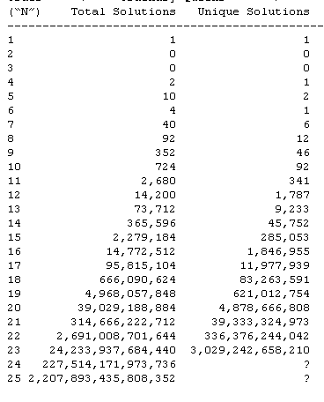
Time complexity :
The Time complexity of N queen increase as we increase the queens.

Slide 10
Code Explaination :
int[,] board = new int[4, 4];
Console.WriteLine("Displaying Positions where \"0\" represents empty locations and \"1\" represents locations of Queens to be placed . ");
if (!theBoardSolver(board, 0))
{
Console.WriteLine("Solution not Possible .");
}
printBoard(board);
Console.WriteLine("Problem solved-Algorithm Implemented .");
Console.ReadLine();

Slide 11
static Boolean toPlaceOrNotToPlace(int[,] board, int row, int col)
{
int i, j;
for (i = 0; i < col; i++)
{
if (board[row, i] == 1) return false;
}
for (i = row, j = col; i >= 0 && j >= 0; i--, j--)
{
if (board[i, j] == 1) return false;
}
for (i = row, j = col; j >= 0 && i < N; i++, j--)
{
if (board[i, j] == 1) return false;
}
return true;
}
static Boolean theBoardSolver(int[,] board, int col)
{
if (col >= N) return true; // checking column is within range or not
for (int i = 0; i < N; i++)
{
if (toPlaceOrNotToPlace(board, i, col)) // yeh condition yeh check kry gi k place krna hai ya nahi koi attack to nahi ho raha
{
board[i, col] = 1; // yahan yeh ho raha hai k hr element ki jga 1 put kr raha hai row wise
if (theBoardSolver(board, col + 1)) return true; // yeh condition column wise 1 ki placement kr rahi hai
board[i, col] = 0;
}
}
return false;
}

Slide 12
THANK YOU

